Slide 1



Italy_GDP
View in Power BI
Last data refresh:
1/3/2023 4:06:36 AM UTC
Downloaded at:
1/3/2023 4:09:38 AM UTC

Slide 2
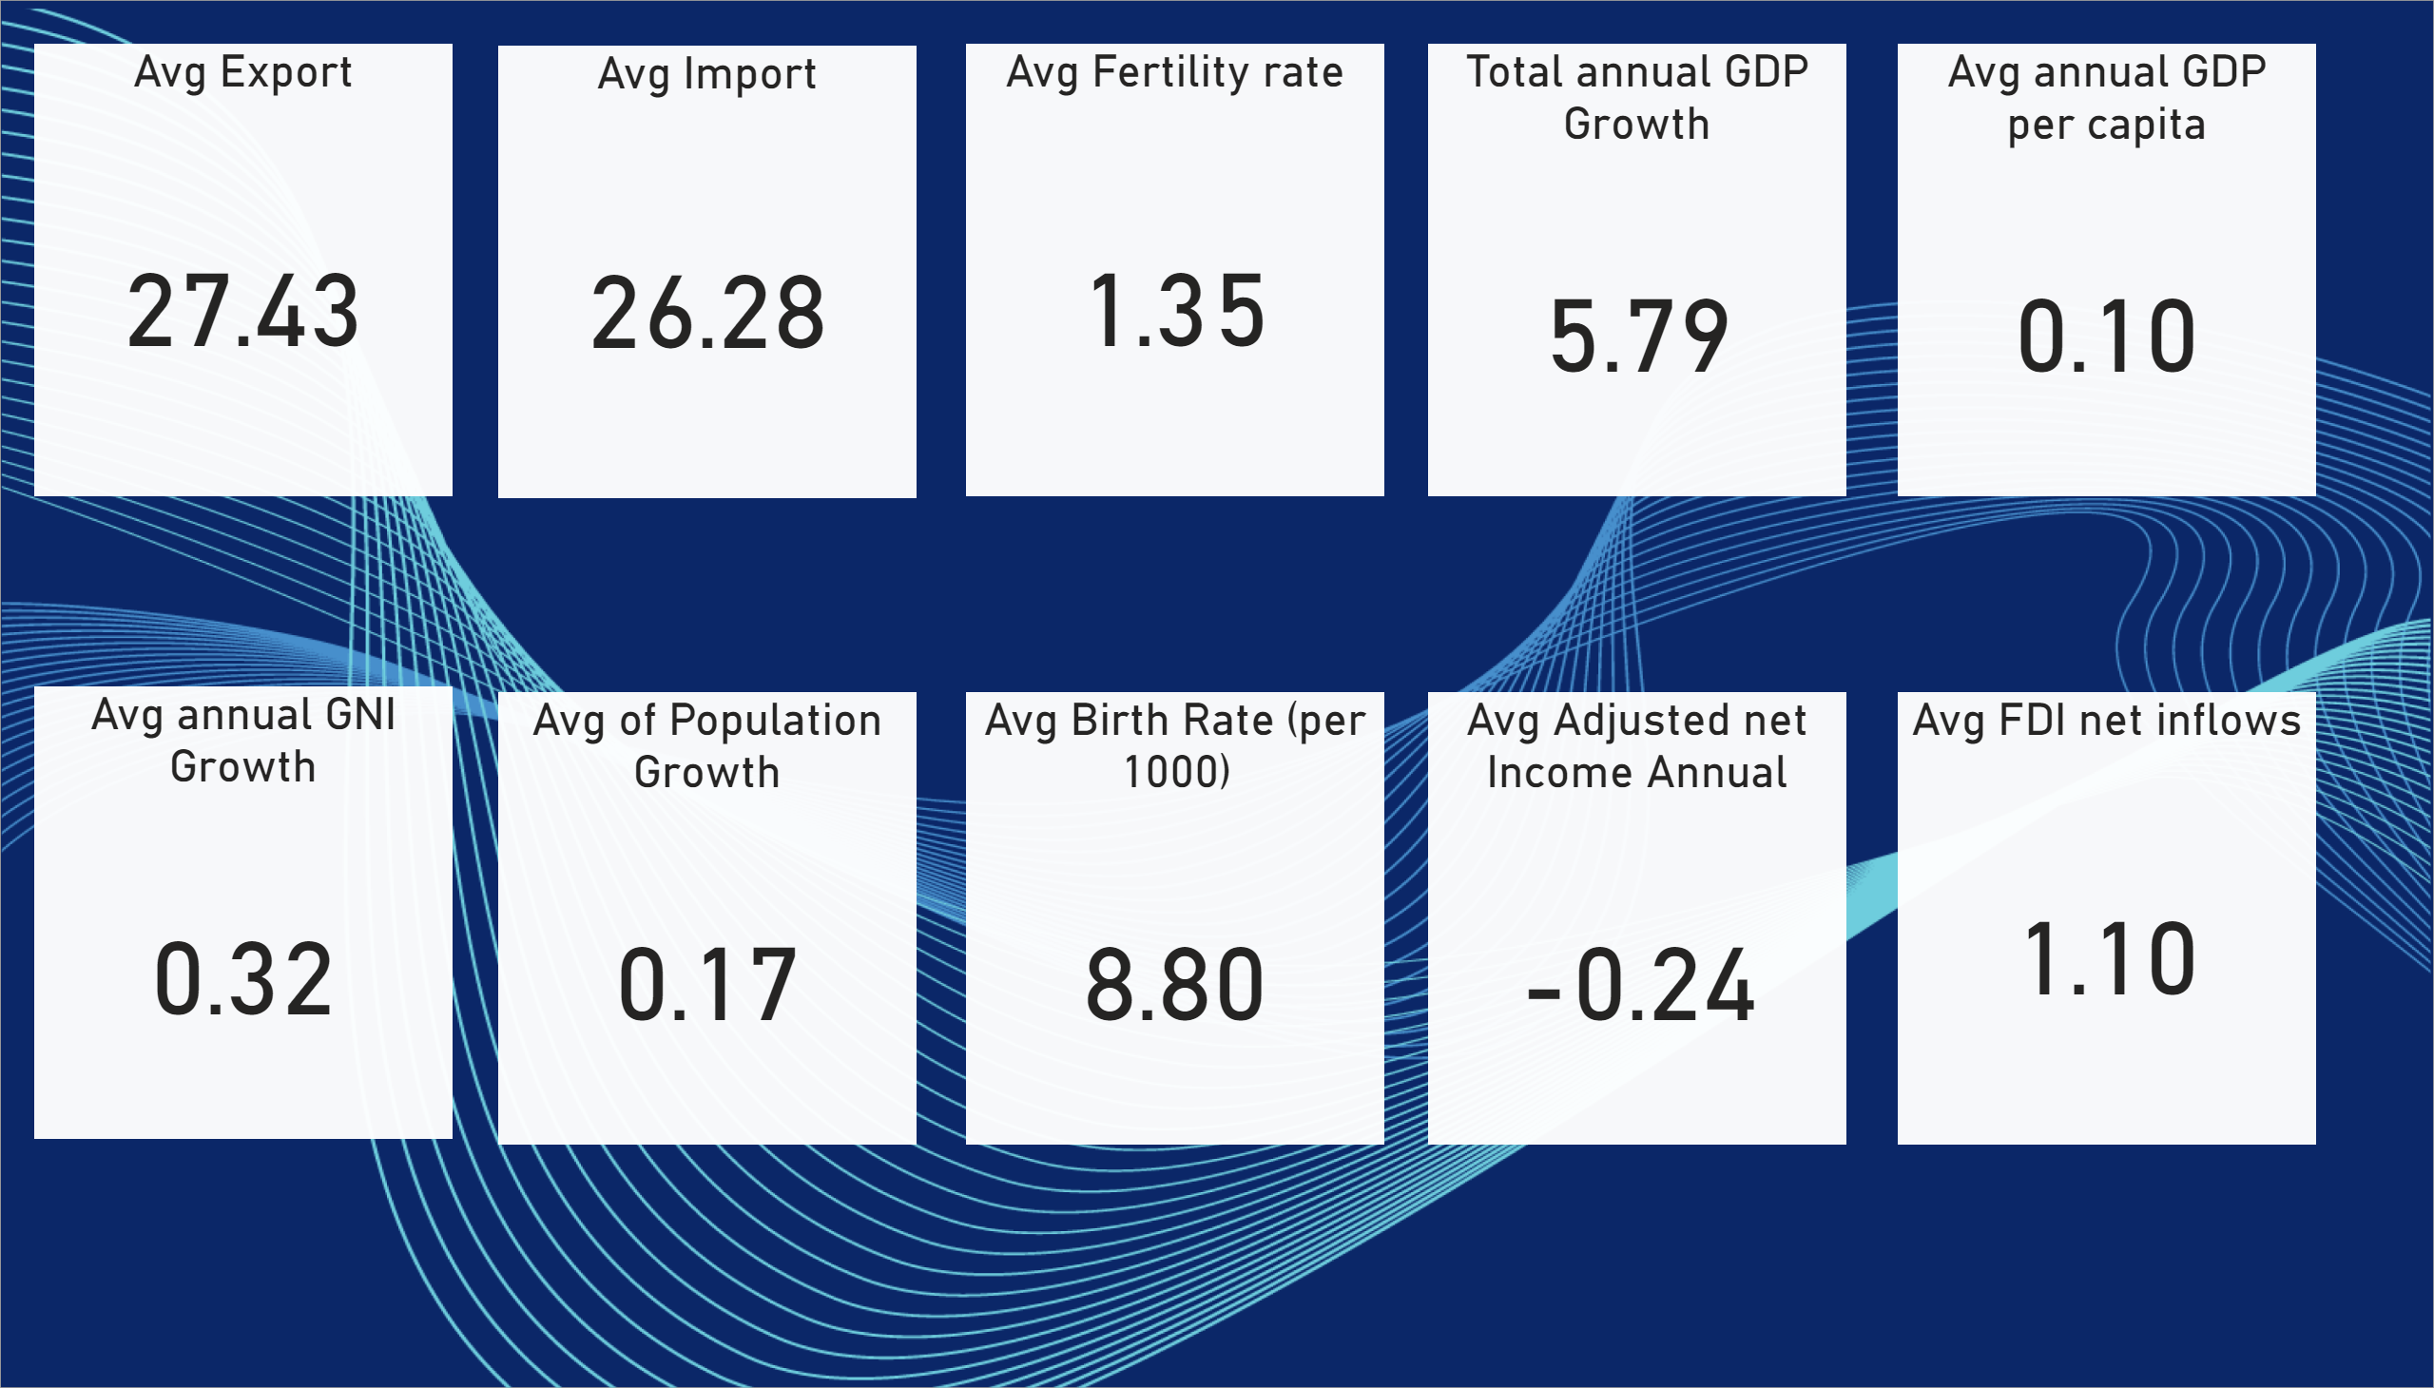
Card
Notes:
Avg Export
No alt text provided
Avg Import
No alt text provided
Avg Fertility rate
No alt text provided
Total annual GDP Growth
No alt text provided
Avg annual GDP per capita
No alt text provided
Avg annual GNI Growth
No alt text provided
Avg of Population Growth
No alt text provided
Avg Birth Rate (per 1000)
No alt text provided
Avg Adjusted net Income Annual
No alt text provided
Avg FDI net inflows
No alt text provided

Slide 3
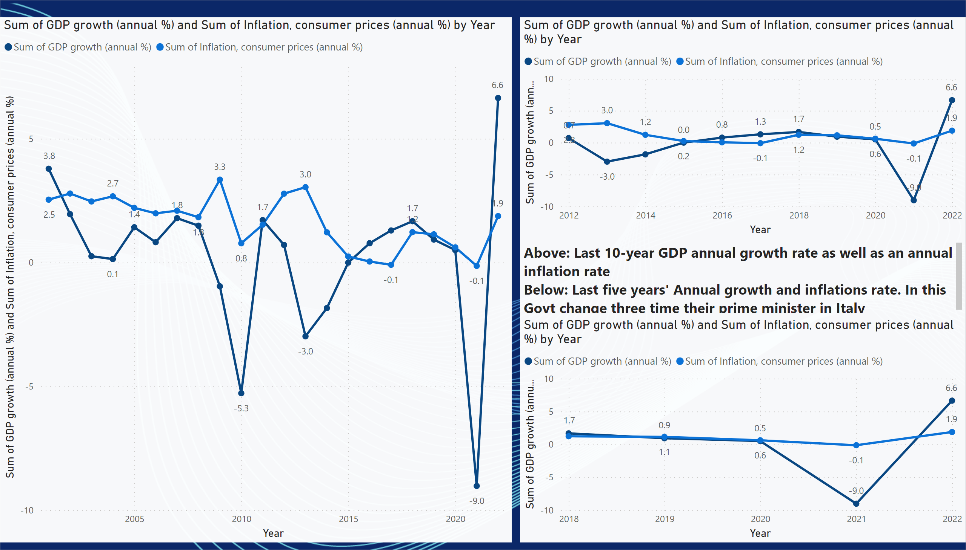
Line Chart
Notes:
lineChart
No alt text provided
lineChart
No alt text provided
lineChart
No alt text provided
textbox
No alt text provided

Slide 4
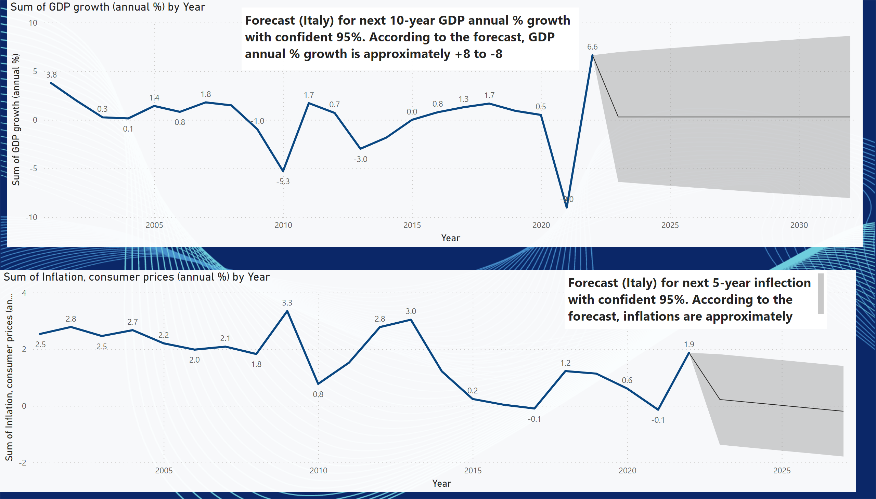
Forecast GDP, Inflation
Notes:
lineChart
No alt text provided
lineChart
No alt text provided
textbox
No alt text provided
textbox
No alt text provided

Slide 5
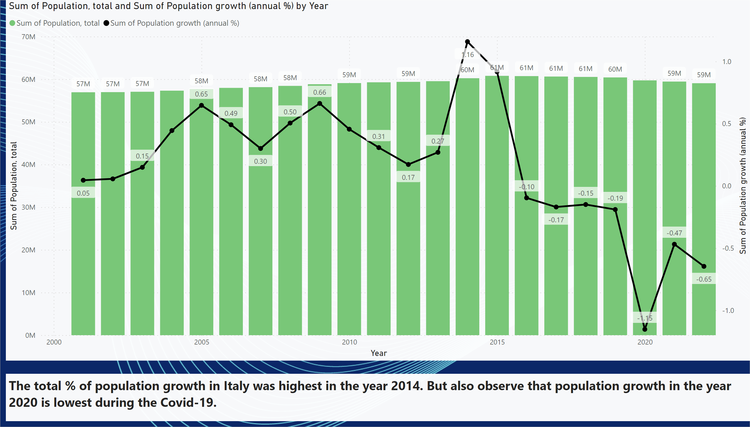
Population
Notes:
lineStackedColumnComboChart
No alt text provided
textbox
No alt text provided

Slide 6
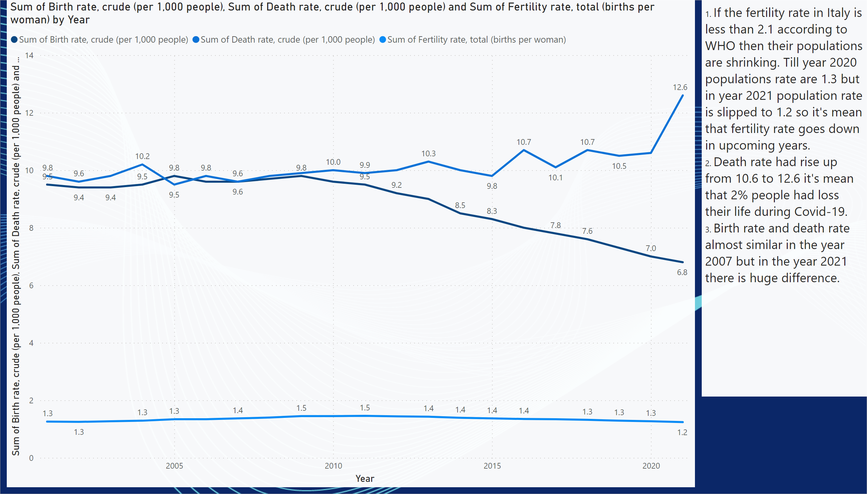
Birth,Death,Infertility
Notes:
lineChart
No alt text provided
textbox
No alt text provided

Slide 7
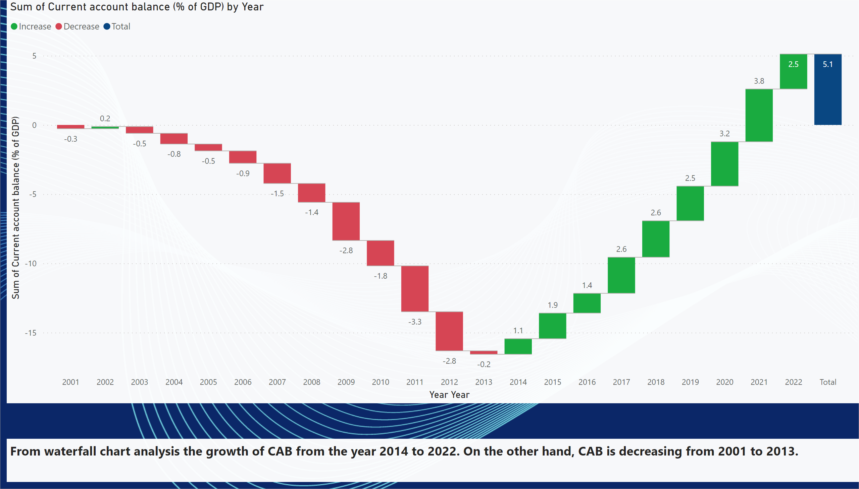
CAB
Notes:
waterfallChart
No alt text provided
textbox
No alt text provided

Slide 8
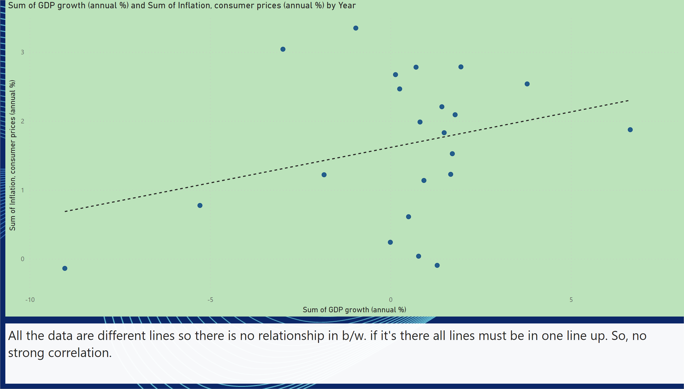
GDP growth vs Inflation
Notes:
scatterChart
No alt text provided
textbox
No alt text provided

Slide 9
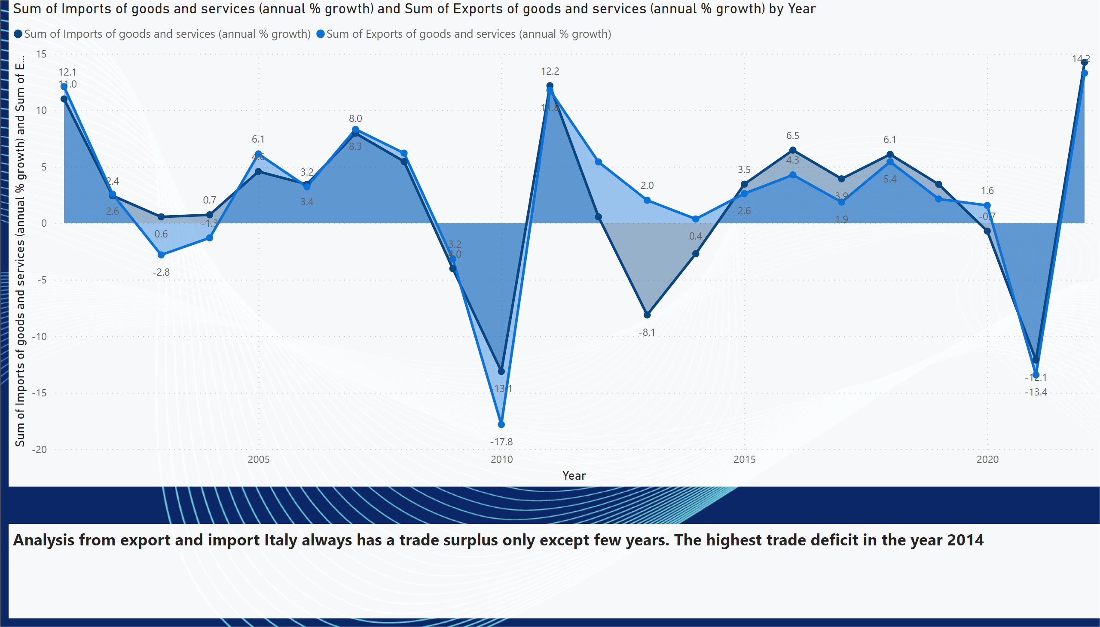
Export vs Import
Notes:
areaChart
No alt text provided
textbox
No alt text provided

Slide 10
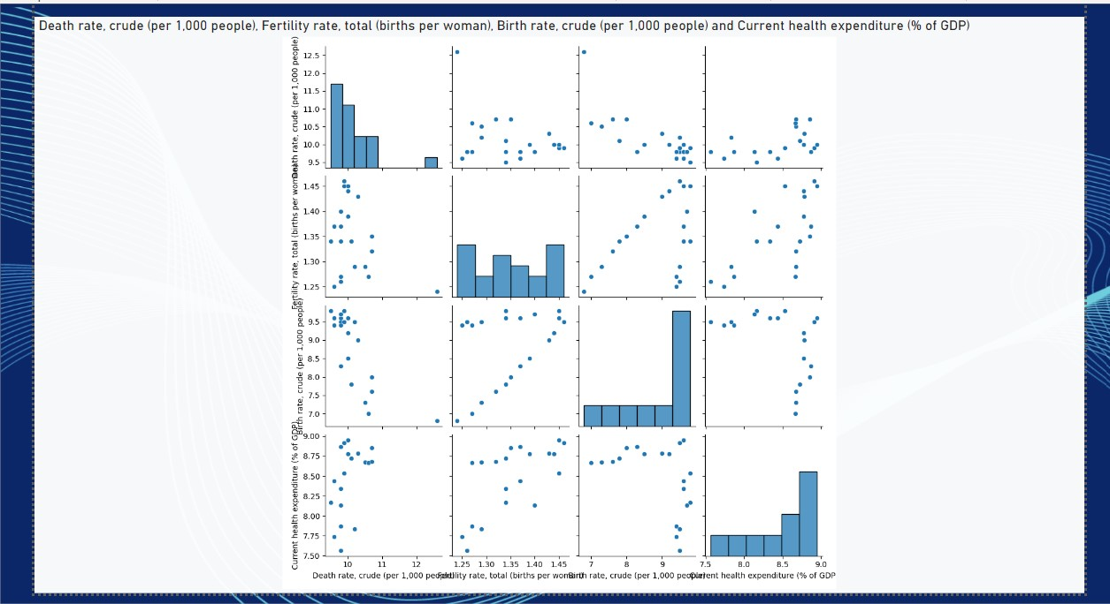
Pairplot of Birth,Death,Fertility, Helath exp
Notes:
pythonVisual
No alt text provided

Slide 11
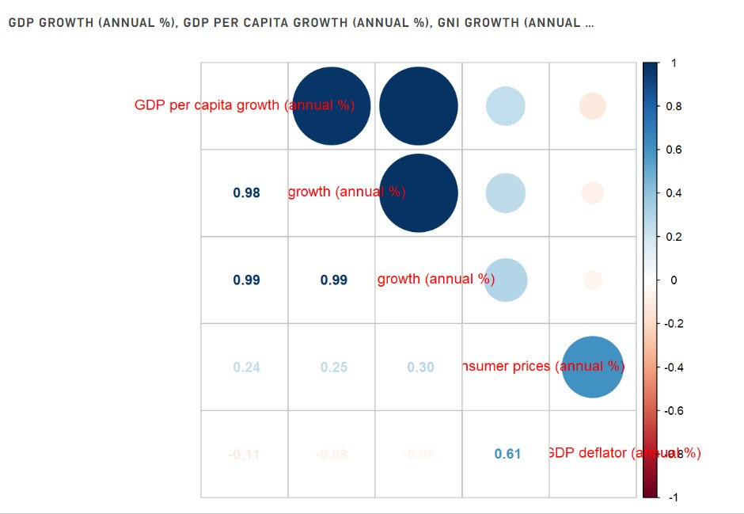
Correlations in R
Notes:
scriptVisual
No alt text provided

Slide 12
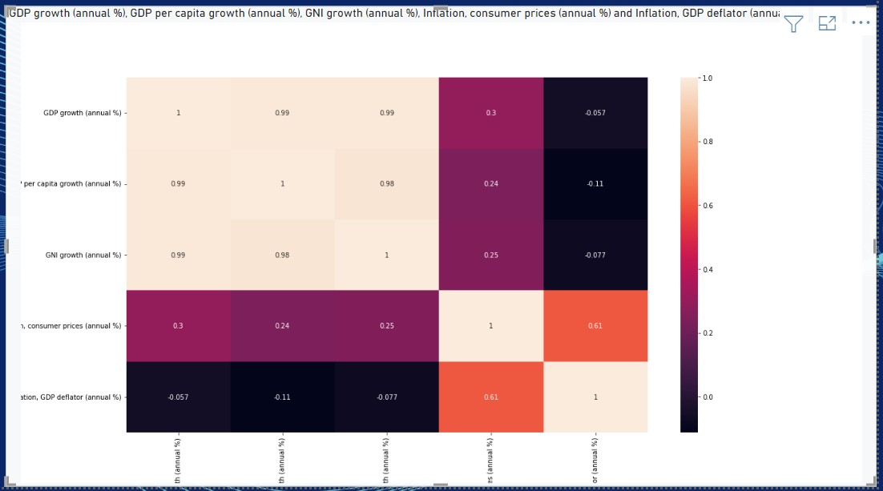
Pairplot in R
Notes:
scriptVisual
No alt text provided

Slide 13
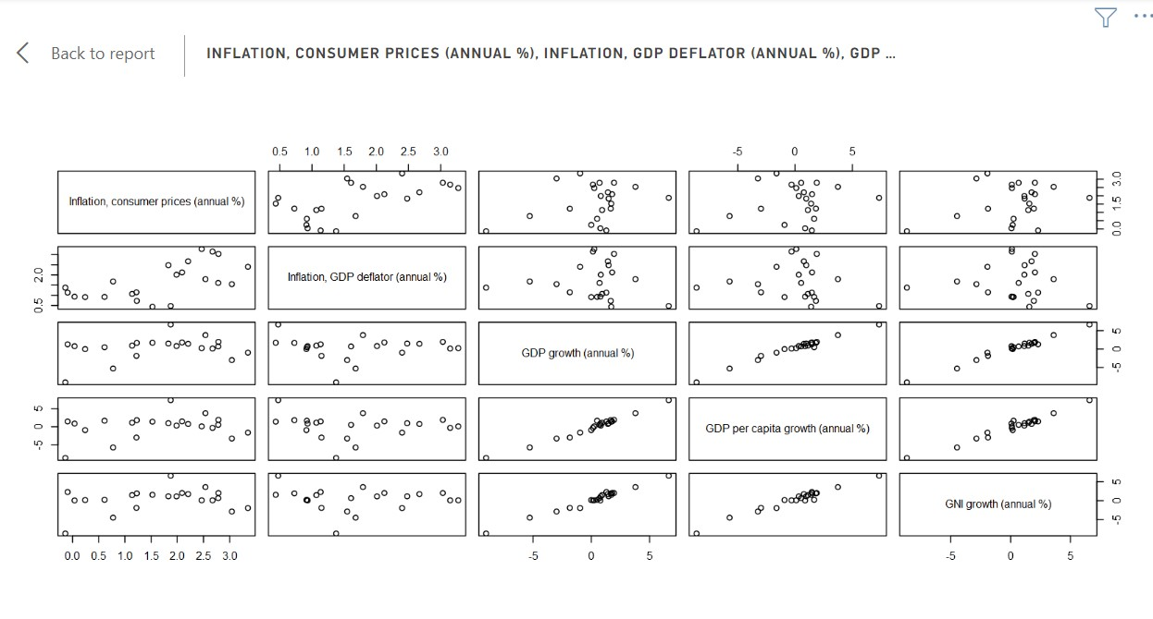

Slide 15
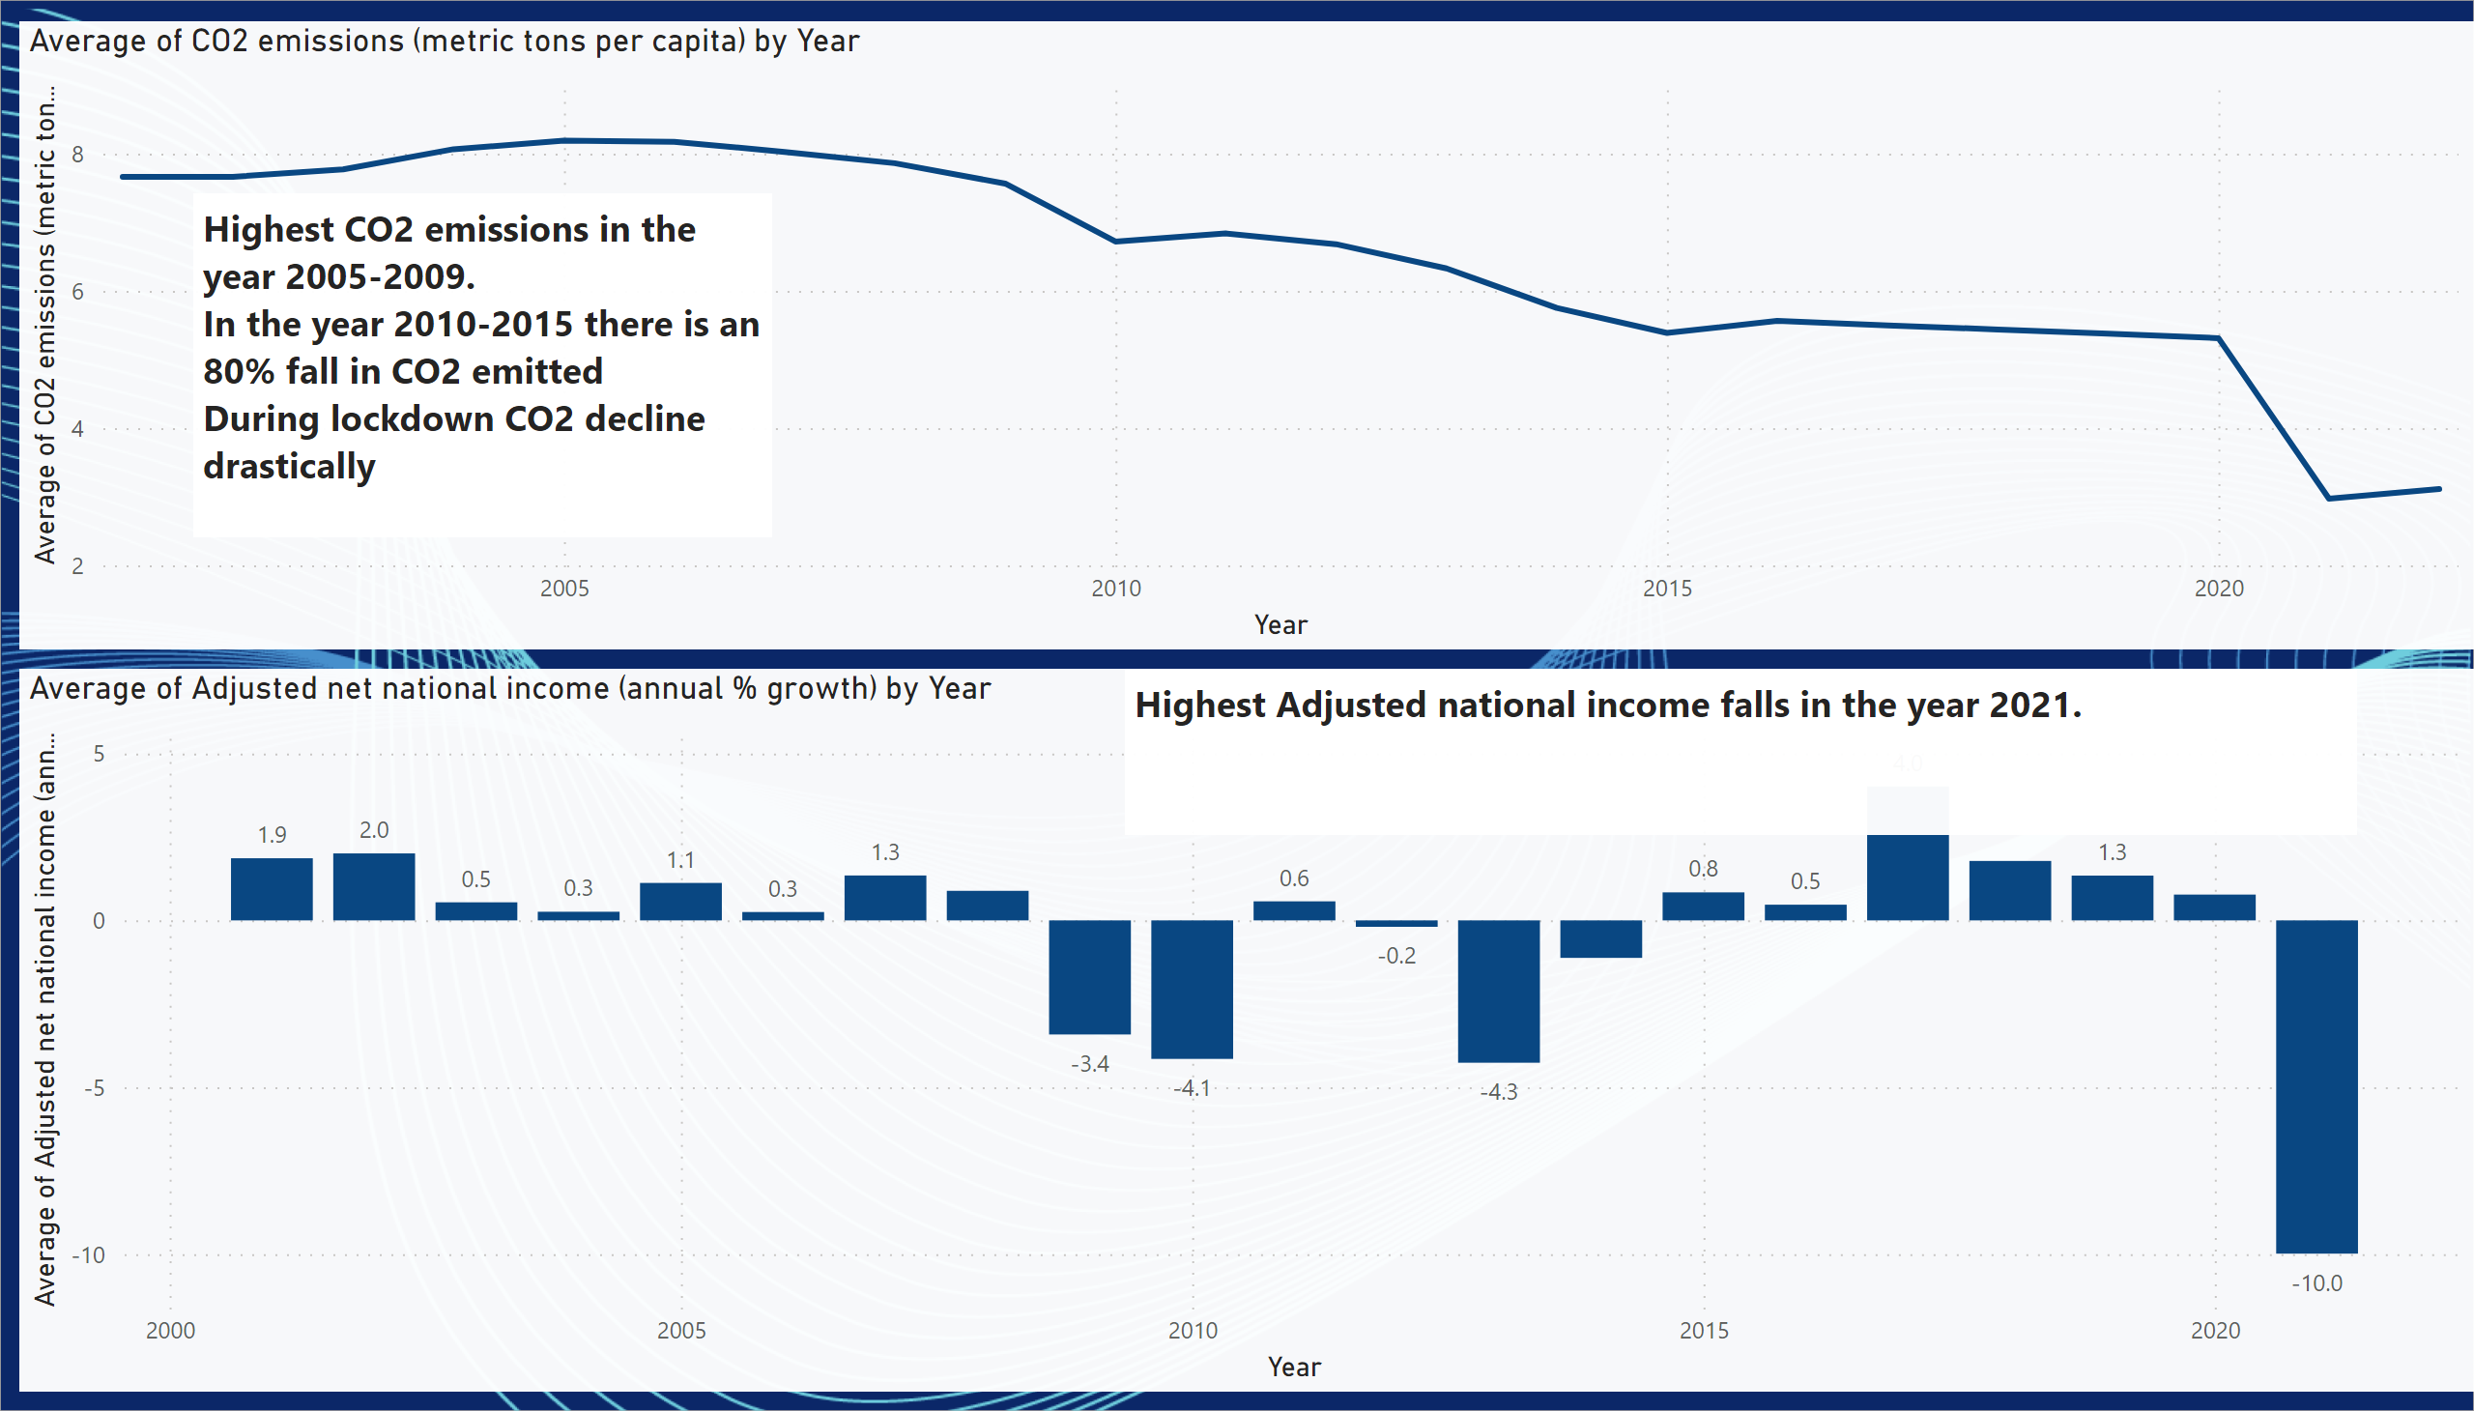
CO2 emit yearwise
Notes:
lineChart
No alt text provided
clusteredColumnChart
No alt text provided
textbox
No alt text provided
textbox
No alt text provided

